Slide 1
Forms
Introduction to Forms | Get and Post Method| Form Widgets | Labels and Text Areas
Notes:
Welcome to our lecture on Forms. In this lecture we will go through an introduction to the forms, Get and Post method, form widgets, and finally we will discuss what are the labels and text area. Let’s start the lecture.

Slide 2
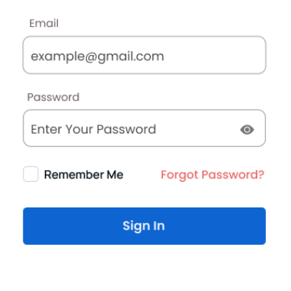
Forms
Form Purpose: The form element enables the browser to submit user information to a server.
Action Attribute: Specifies the URL where the form data is sent, usually via HTTPS for encryption.
Method Attribute: Defines the HTTP request type (GET or POST), with GET as the default if unspecified.
Notes:
Forms allow the browser to submit user data to a server. The action attribute specifies the URL where the data is sent, often using HTTPS for security. The method attribute defines the HTTP request type, either GET or POST, with GET as the default. Forms are essential for collecting and transmitting user input securely and efficiently in web applications.

Slide 3
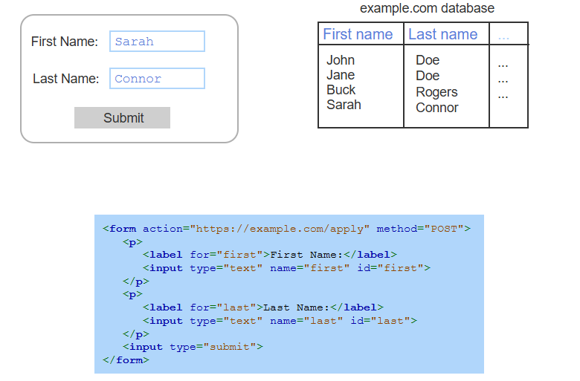
Example of Forms
Notes:
This example demonstrates a form where users input their first and last names. The form uses labels and input elements with attributes like name and id to collect data. When submitted, the data is sent via the specified action URL using the POST method and stored in a database. This process highlights how forms handle user input and transmit it to a server for storage or processing.

Slide 4
Get Method
GET Method: Sends form data to a server by appending it to the URL as a query string.
Query String: Data is formatted as name=value pairs, separated by ampersands (&).
URL Creation: Combines the form's action URL, a question mark (?), and the query string.
Request & Response: Sends an HTTP GET request and updates the webpage with the server's response.
Notes:
The GET method sends form data to a server by appending it to the URL as a query string. The query string is formatted as name-value pairs separated by ampersands. The URL is created by combining the form's action URL, a question mark, and the query string. This URL is sent as an HTTP GET request, and the server's response updates or displays the webpage content.

Slide 5
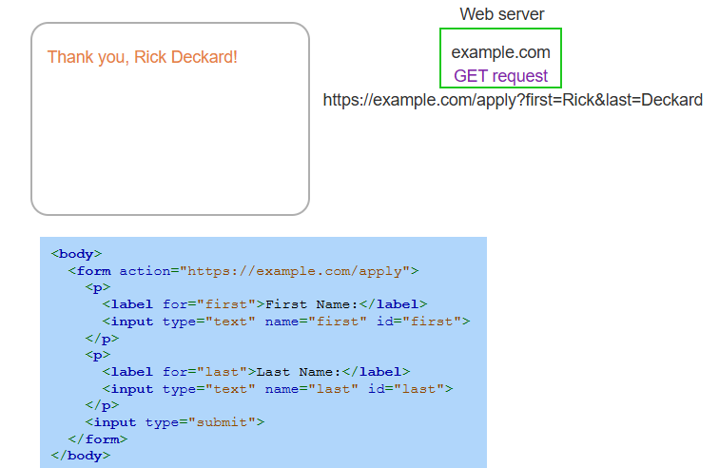
Form Submission Using Get Method
Notes:
This example demonstrates form submission using the GET method. The form collects user input for first and last names and sends the data as a query string appended to the URL. The browser creates an HTTP GET request using the URL and sends it to the server. The server processes the request and responds with an updated webpage, displaying a thank-you message including the submitted name.

Slide 6
Post Method
POST Method: Sends form data in the HTTP request body, not in the URL.
Request Creation: Uses the form's action URL to create an HTTP POST request.
Data Handling: Formats form data as a query string and places it in the request body.
Response: Updates or displays the webpage using the server's response.
Notes:
The POST method sends form data in the HTTP request body rather than the URL. The browser uses the form's action URL to create a POST request, formats the form data as a query string, and places it in the request body. The server processes the request and responds, updating or displaying the webpage with the appropriate content.

Slide 7
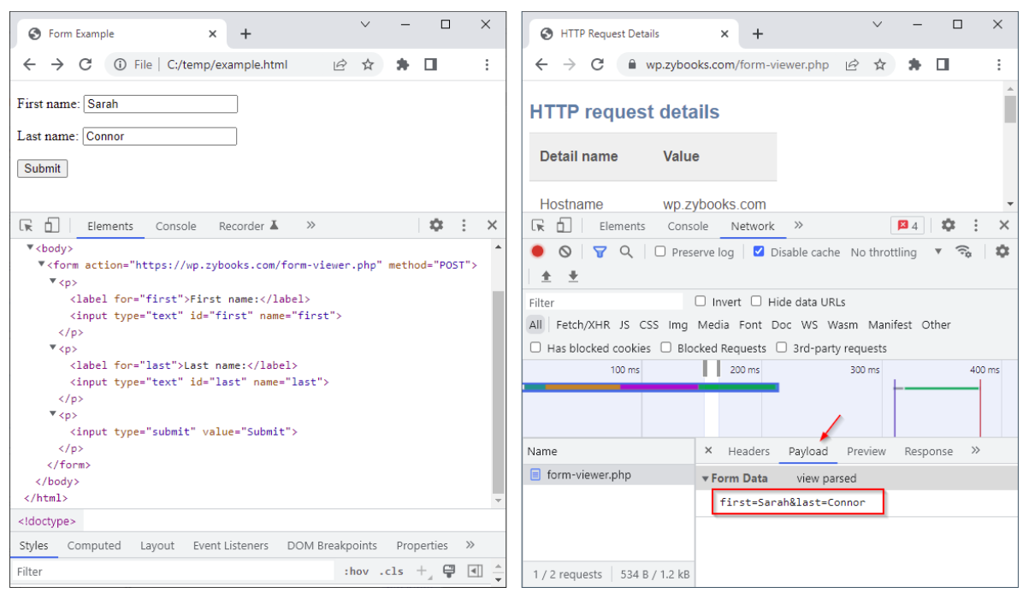
Chrome Dev Tools showing form data in POST request
Notes:
This example demonstrate the post request. The left side of the figure below shows a webpage opened in Chrome. The Dev Tools show the page's form, which is Posting to a zyBooks URL. The user entered her name Sarah Connor before pressing Submit. On the right, the user has pressed Submit, and the Dev Tools show the details of the HTTP request. The Payload tab shows the query string created from the form data.

Slide 8
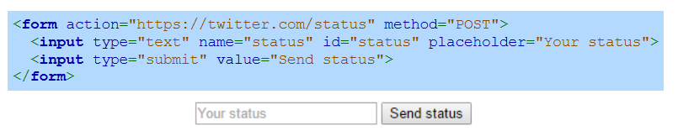
Complete HTML form sending status to Twitter using a secure HTTP POST request
Notes:
This is another example of post request. The HTML asks for a message to tweet. The text box widget does not use the value attribute because no default tweet message makes sense. The submit button does not use the name attribute because the submit button's value is not needed by the web server.

Slide 9
Form Widgets
Widgets: Interactive components like buttons, drop-downs, and text fields for user interaction.
Text Box: Input element with type="text" for single-line input.
Submit Button: Input element with type="submit" that sends form data when clicked.
Notes:
Now move on to Form widgets that are interactive elements like buttons, drop-downs, and text fields for user interaction. A text box is created using an input element with type set to "text" for single-line input. A submit button is an input element with type set to "submit," which sends the form data to the server when clicked. These widgets enable users to interact and input data in web forms effectively.

Slide 10
Form Widgets
Input Element: Creates widgets for user input; void element with key attributes:
Type: Defines widget type (e.g., text, password, submit).
Name: Names widget and sends value with form submission.
ID: Assigns a unique identifier.
Placeholder: Displays hint text in text widgets.
Value: Sets default widget value.
Notes:
Here are some attributes of input element. The input element creates widgets for user input and is a void element with essential attributes. The type attribute defines the widget type, such as text or submit. The name attribute identifies the widget and sends its value with form submissions. The id assigns a unique identifier. The placeholder shows hint text for users, and the value sets a default input. These attributes enhance form usability and functionality.

Slide 11
Labels and Text Area
Label Element: Provides descriptive text for a specific widget using the for attribute, which matches the widget's id, aiding screen reader accessibility.
Text Area Widget: Allows multi-line text input using the textarea element, with optional rows and cols attributes to set its initial size.
Notes:
Finally we will discuss the labels and text area. The label element provides descriptive text for widgets, using the for attribute to link with the widget's id, enhancing screen reader accessibility. The text area widget allows multi-line text input and is created using the text area element. Optional rows and cols attributes define its initial size, making it flexible for various input needs. These elements improve form usability and accessibility.

Slide 12
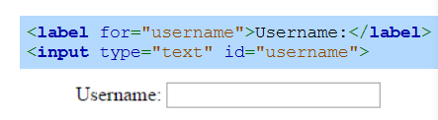
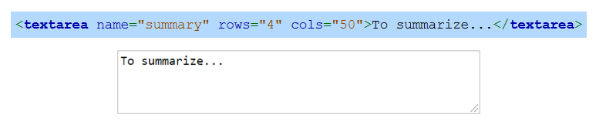
Labels and Text Area Examples
Label:
Text Area:
Notes:
This slide illustrates the example of labels and text area. The label element links descriptive text to a specific input widget using the for attribute, improving accessibility. In this example, a label for a username input is shown. The text area element creates a multi-line text input field, with rows and cols attributes specifying its size. Here, the text area is used to input a summary, demonstrating its flexibility for larger text entries.

